Slide 1
Coursera – Capstone Project

Slide 2
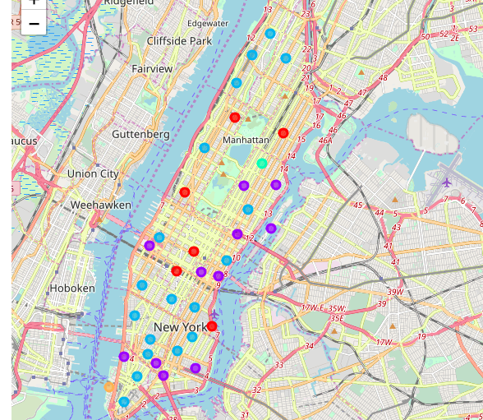
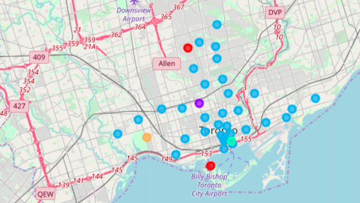
Comparing Clusters for Similarity Based on Silhouette Measure
Clusters of Neighborhood in NY
Clusters of Neighborhood in Toronto

Slide 3
Methodology & Results
Methodology
Results
Postal code data for Canada & New York is used as input
Foursquare API is used for deriving venues around neighborhoods.
Kmeans clustering technique is used for clustering neighborhoods.
Silhouette measure is used for comparing the similarity between clusters
The Silhouette score for New York cluster not densely populated.
Clusters for Toronto are well separated suggesting that clusters from NY & Toronto are not similar.

